Slide 2
Building a video conferencing app using Amazon Web Services
Martin Gillen, Software Development Lead
January 8, 2020

Slide 3




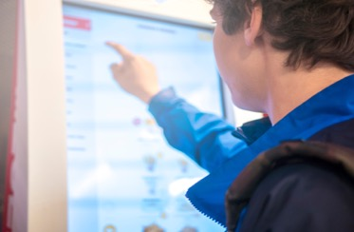



Customers want real-time communications in their applications
Telehealth
Distance Education
Gaming
Banking Kiosks
Retail Kiosks
Sales/Support
Enterprise Meetings
Unified Comms
Live interactions drive a deeper level of customer engagement

Slide 4



Building real-time communications in apps is challenging
Development Overheads
Heavy lift to build from scratch
Long delivery times
Skills outside core competency
Operational Complexity
Deploy and manage infrastructure
Meet quality & reliability expectations
Optimize costs
Limited Extensibility
Complex 3rd-party integrations
Keep up w/ AI & ML-enabled solutions
Cross-service security
Higher time-to-market, costs and limited features

Slide 5

AWS can bring proven building blocks & expertise to help
Audio, video, screen share & PSTN calling
Powering real-time interactions every day across leading operating systems and browsers.
Operational expertise in RTC at scale.
Support in 14 AWS regions and phone numbers in 140 countries with carrier relationships.
Meetings & chat service by AWS

Slide 6



Introducing Amazon Chime SDK
Embed proven real-time communication capabilities in your apps
JavaScript Client SDK
AWS SDK
Media Services
Embed in client side application to initiate, control & terminate media sessions.
Use Chime APIs in server side application to create & manage media resources.
Media sessions & services to support audio calling, video calling & screen sharing.

Slide 7
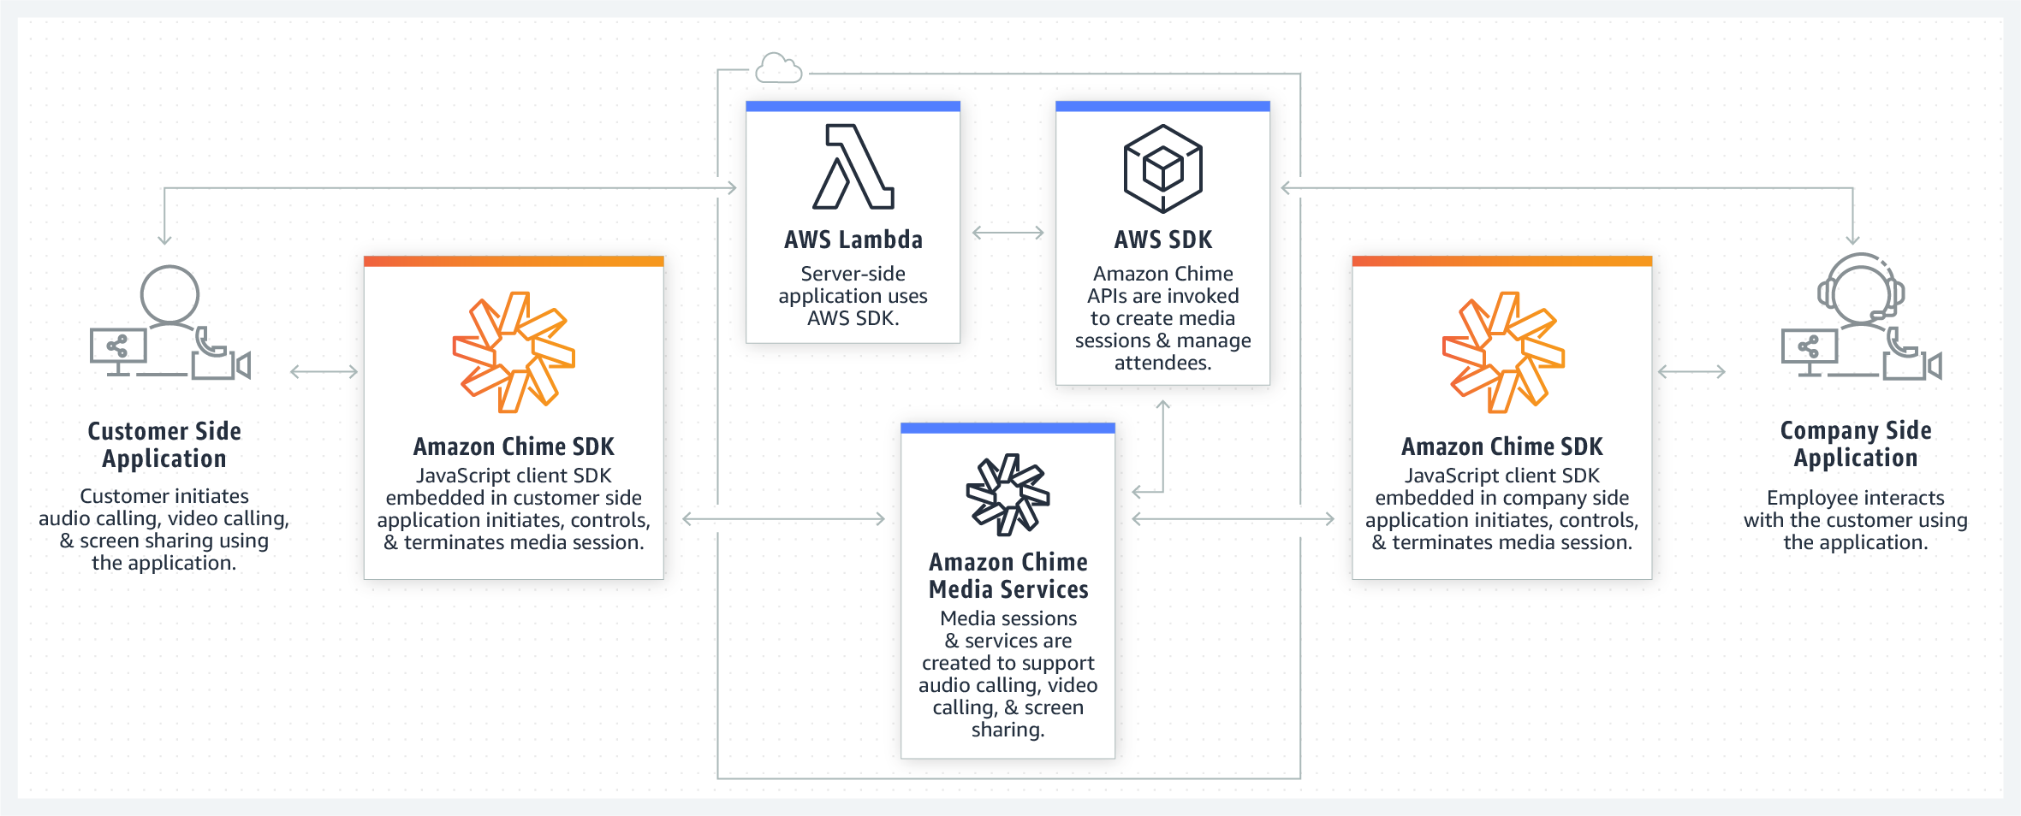
How it works

Slide 8
Simplify the end-to-end development & operational lifecycle
HD video (720p), 16 streams, customizable bandwidth policies
Audio for up to 100 attendees w/ real-time events for active speaker, signal strength, volume
Screen sharing with zoom in/out controls
Device controller to abstract device management and video quality
Stats collector for client-side media quality metrics
AWS SDKs with Identify and Access management policies
Build
Host meetings across 14 AWS regions 32 AZs; closest to where users are
Traverse corporate firewalls and NATs using Amazon Chime TURN services
24x7 monitoring with AWS Service Health Dashboard (SHD) updates
Redundant, high-speed AWS networking backbone
Operate
Integrate
PSTN dial-in with Amazon Chime Voice Connector integration
Real-time meeting events with Amazon EventBridge, SNS and SQS
Transcription & sentiment analysis with Amazon Transcribe & Amazon Comprehend.

Slide 9



Now empower your apps with real-time communications
Build faster
Ready to integrate SDKs
Abstract away WebRTC complexity
Get to market quickly
Simplify Operations
Enterprise-ready in 14 AWS regions
Pre-configured
No deployments required
Extend Your Apps
PSTN calling management
Add AI/ML capabilities
Trigger workflows by events
Reduce time to market, costs and overheads.

Slide 10
BUILDING THE APP

Slide 11


High-level Conceptual Diagram
AWS SDK & Media Services
Client Side JavaScript SDK
MeetingSession
Media Session
Media URLs
MeetingSessionConfiguration
Media URLs
AudioVideoFacade
Attendee
Attendee
ScreenShareFacade
Join Token
Join Token
ScreenShareViewFacade
DeviceController
Logger

Slide 12










Architecture
Service
Application
Amazon Chime
Media Control Plane
Amazon
CloudWatch
Amazon Simple Notification Service
Amazon Simple
Queue Service
AWS SDK
Web App
IAD
SYD
Amazon
Chime SDK
PSTN Media
Service
…
Amazon Chime
Media Data Plane
14 AWS regions
Amazon Chime
Media Data Plane
AWS SDK
Amazon Chime
Voice Connector
Amazon Kinesis
Video Streams
Amazon
Transcribe
Phone

Slide 13
Service application: meeting and attendee creation
Integrate the AWS SDK actions into a service application:
CreateMeeting
Params: Configuration, MediaRegion
Response: MeetingId, MeetingSessionUrls
CreateAttendee
Params: ExternalUserId
Response: ExternalUserId, AttendeeId, JoinToken
Service
Application
Web App
Amazon Chime
Media Control Plane
Amazon
Chime SDK
AWS SDK

Slide 14
Web application: meeting join
Integrate Amazon Chime SDK into your web application:
Populate meeting configuration
Create a meeting session
Setup capture and render devices
Add observers
Start audio or audio-video
Bind video tiles to HTML elements
Amazon Chime
Media Control Plane
IAD
Web App
Amazon
Chime SDK
Amazon Chime
Media Data Plane
…
14 AWS regions
SYD
Amazon Chime
Media Data Plane

Slide 15
PSTN join
Leverage Amazon Chime Voice Connector to enable PSTN joins:
Create a voice connector
Purchase a phone number
Configure origination to send calls to the Attendant Service
Implement conference lookup
On success, invoke CreateAttendee to retrieve a Session Initiation Protocol (SIP) Uniform Resource Identifier (URI) for joining
Configure termination to send calls to the SIP URI
PSTN
Meeting Service
AWS SDK
Amazon Chime
Media Control Plane
Phone
Amazon Chime
Voice Connector
Amazon Chime
Media Data Plane

Slide 16
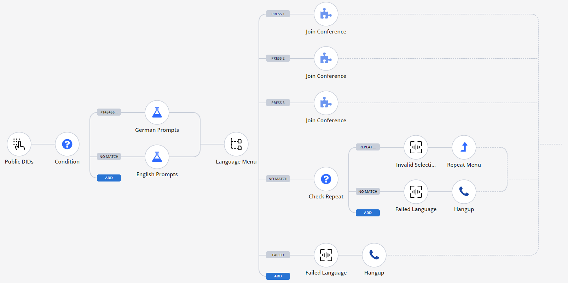
PSTN Workflow

Slide 17
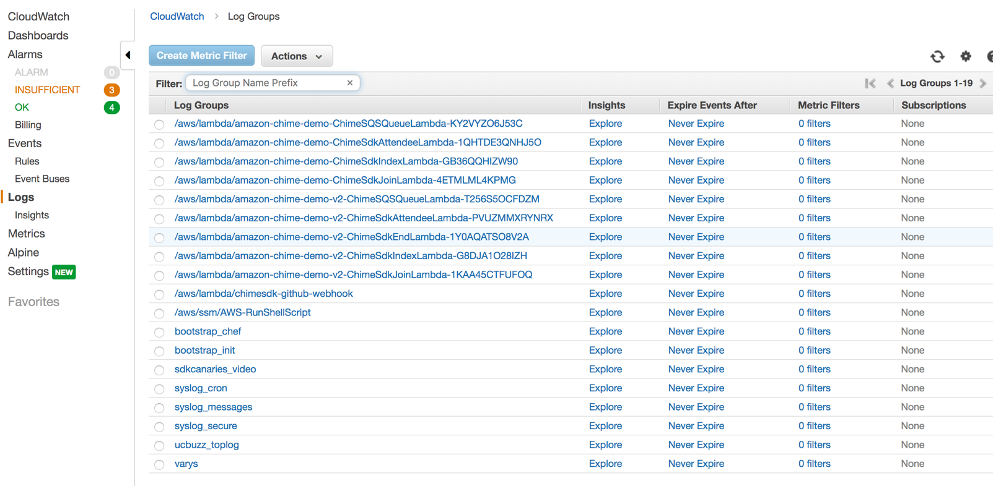
CloudWatch Events, Metrics, Logs

Slide 18
DEMO

Slide 19
martin.gillen@mitel.com

